Slide 1
Computer Vision
Numerical Image Understanding

Slide 2


Plan
Image analysis
Pixel notions
Image histogram
Image filtering
Convolution filtering
Spatial frequency
Mathematical morphology operations
Erosion / dilation
Opening / closing

Slide 3
Image Analysis
Pixel notions & histograms

Slide 4
Pixel notions
Grayscale
Width
(0, 0)
Image sampling : divide image in small areas (pixels) containing a value (or a list of values)
Coordinates : Line / Width & Column / Height
Quantification : number of possible values
Definition : W X H
Resolution : Pixels / Length unit
Compression
250 | 249 | 249 | 248 | 242
246 | 244 | 243 | 228 | 230
244 | 242 | 240 | 230 | 231
241 | 240 | 240 | 229 | 230
... | ... | ... | ... | ...
Height

Slide 5
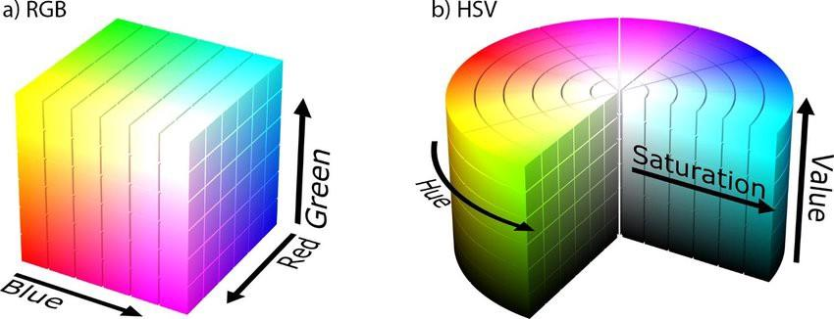
Colors

Slide 6
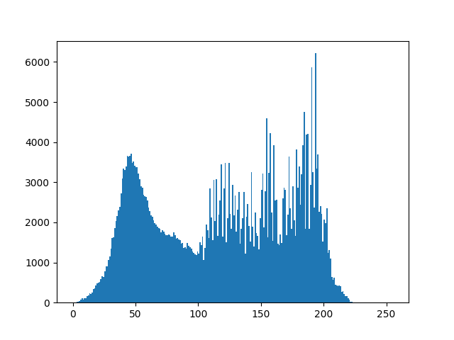
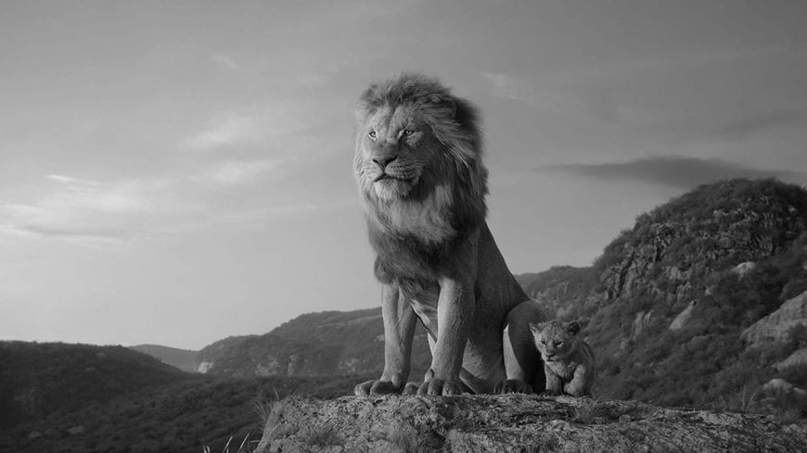
Image Histogram
Original
Pixels number
Grayscale

Slide 7
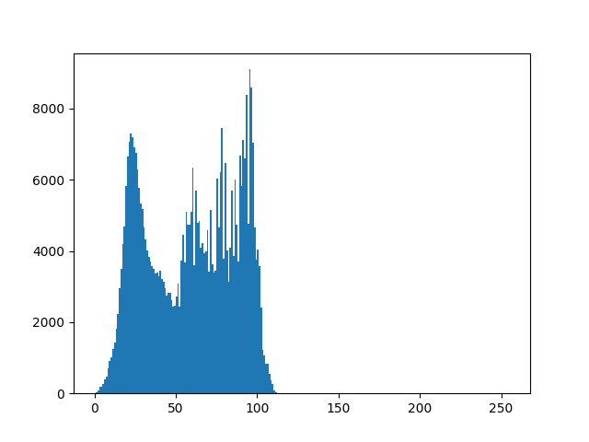
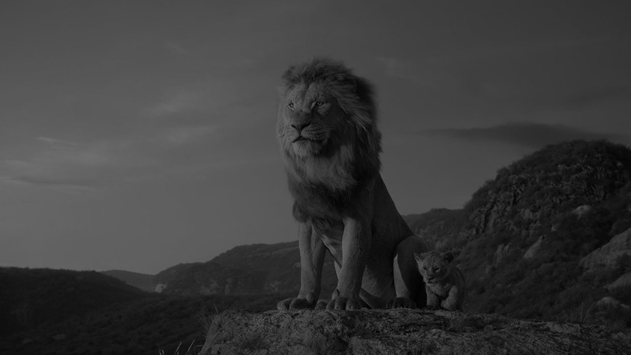
Image Histogram
Under exposed
Pixels number
Grayscale

Slide 8
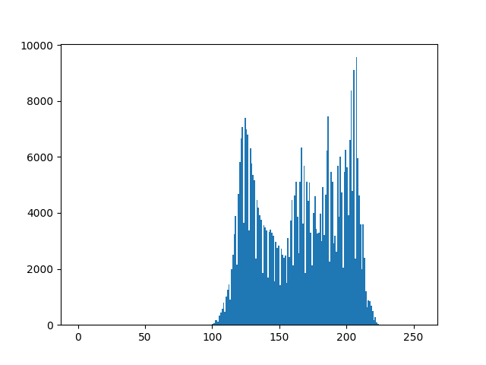
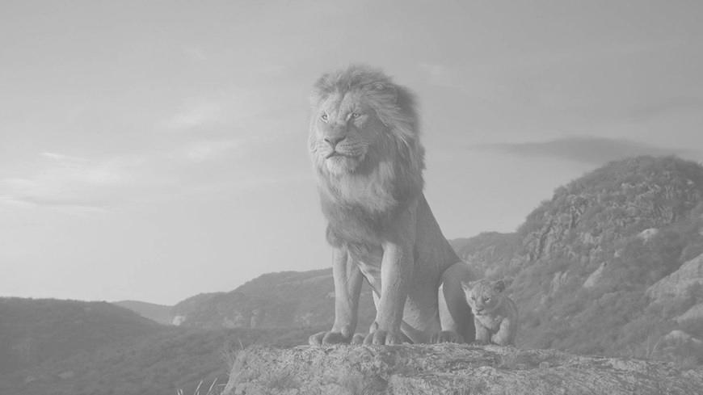
Image Histogram
Over exposed
Pixels number
Grayscale

Slide 9
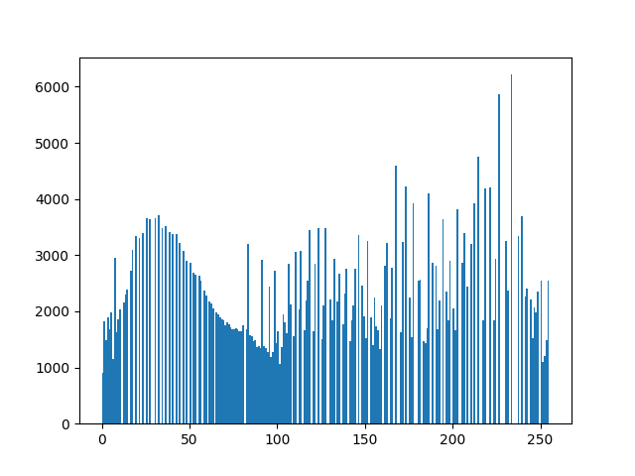
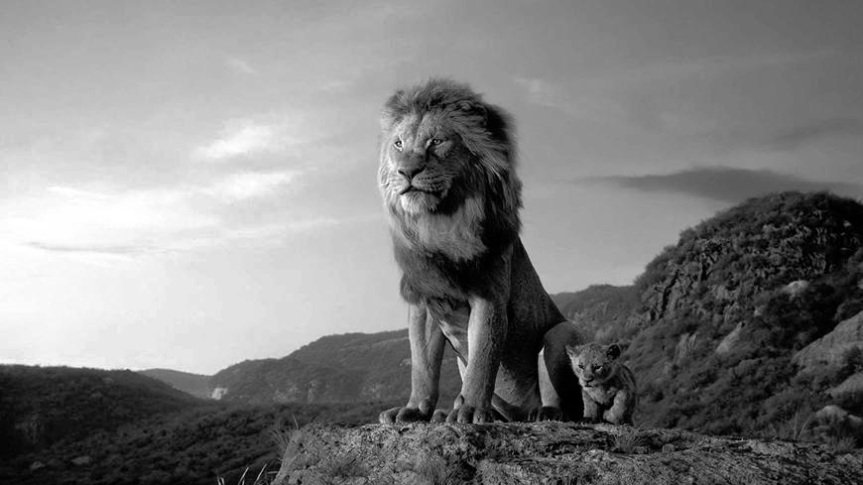
Histogram Equalization
Contrast adjusted
Pixels number
Grayscale

Slide 10
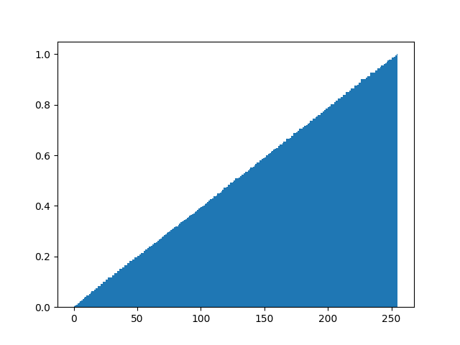
Histogram Equalization
Contrast adjusted
Cumulative Pixel Frequency
Grayscale

Slide 11
Classical transformations
Brightness: intensity measure (dark vs. fade / bright)
Contrast : difference in brightness between dark and bright pixels
Histogram equalization
Geometrical: translation / zoom / rotation
Image compression
Filtering : Noise removal / adding
Notes:
Une première idée pour économiser de l’espace lors du stockage est d’essayer d’exploiter les zones d’image où les pixels voisins sont identiques. Il existe d’autres principes comme le codage entropique (qui vise à représenter les valeurs d’origine par un code à longueur variable, d’autant plus court que la valeur est fréquente, et long quand la valeur est rare) ou aussi le codage par dictionnaire (qui remplace des combinaisons de valeurs d’origine par une marque courte, qui sera mémorisée dans un dictionnaire, servant au remplacement inverse pour reconstituer la matrice de pixels).
Pour ce faire, le principe ne consiste généralement pas directement à uniformiser des pixels voisins, mais plutôt à appliquer d’abord une transformée fréquentielle sur l’image (cf. chapitres suivants), puis opérer les transformations avec pertes dans cet espace (par exemple, ne pas enregistrer les hautes fréquences qui sont de petits détails presque imperceptibles).

Slide 12
Image Filtering
Convolution & Spatial Frequency

Slide 13
Convolution (or linear) Filtering
Defined by:
The support (shape of the kernel)
The pixel in the center
An algorithm
Math operator (convolution)
Y = H * X
Image array after filtering
Image array before filtering
Kernel
Notes:
Diff between linear and non linear filtering = https://dsp.stackexchange.com/questions/14241/what-is-the-difference-between-linear-and-non-linear-filters

Slide 14
Neighbors Averager Filter
Kernel
1/9 | 1/9 | 1/9
1/9 | 1/9 | 1/9
1/9 | 1/9 | 1/9
Convolution
(1*141+1*158+1*174+1*184+1*90+1*205+1*175+1*129+1*113) / 9
141 | 158 | 174 | 170 | 168
184 | 90 | 205 | 196 | 204
175 | 129 | 113 | 125 | 201
155 | 164 | 195 | 145 | 109
169 | 222 | 235 | 146 | 182
141 | 158 | 174 | 170 | 168
184 | 152 | 205 | 196 | 204
175 | 129 | 113 | 125 | 201
155 | 164 | 195 | 145 | 109
169 | 222 | 235 | 146 | 182
Before
After

Slide 15
Neighbors Averager Filter
Kernel
1/9 | 1/9 | 1/9
1/9 | 1/9 | 1/9
1/9 | 1/9 | 1/9
Convolution
(1*158+1*174+1*170+1*90+1*205+1*196+1*129+1*113+1*125) / 9
141 | 158 | 174 | 170 | 168
184 | 90 | 205 | 196 | 204
175 | 129 | 113 | 125 | 201
155 | 164 | 195 | 145 | 109
169 | 222 | 235 | 146 | 182
141 | 158 | 174 | 170 | 168
184 | 152 | 151 | 196 | 204
175 | 129 | 113 | 125 | 201
155 | 164 | 195 | 145 | 109
169 | 222 | 235 | 146 | 182
Before
After

Slide 16
Gaussian Filter
Kernel
1/16 | 2/16 | 1/16
2/16 | 4/16 | 2/16
1/16 | 2/16 | 1/16
Convolution
(1*141+2*158+1*174+2*184+4*90+2*205+1*175+2*129+1*113) / 16
141 | 158 | 174 | 170 | 168
184 | 90 | 205 | 196 | 204
175 | 129 | 113 | 125 | 201
155 | 164 | 195 | 145 | 109
169 | 222 | 235 | 146 | 182
141 | 158 | 174 | 170 | 168
184 | 145 | 205 | 196 | 204
175 | 129 | 113 | 125 | 201
155 | 164 | 195 | 145 | 109
169 | 222 | 235 | 146 | 182
Before
After

Slide 17
Borders management
 | 141 | 158
 | 184 | 90
? | ? | ? | ? | ?
? | 152 | 205 | 196 | ?
? | 129 | 113 | 125 | ?
? | 164 | 195 | 145 | ?
? | ? | ? | ? | ?
0 | 0 | 0 | 0 | 0
0 | 152 | 205 | 196 | 0
0 | 129 | 113 | 125 | 0
0 | 164 | 195 | 145 | 0
0 | 0 | 0 | 0 | 0
152 | 152 | 205 | 196 | 196
152 | 152 | 205 | 196 | 196
129 | 129 | 113 | 125 | 125
164 | 164 | 195 | 145 | 145
164 | 164 | 195 | 145 | 145
141 | 158 | 174 | 170 | 168
184 | 90 | 205 | 196 | 204
175 | 129 | 113 | 125 | 201
155 | 164 | 195 | 145 | 109
169 | 222 | 235 | 146 | 182
Zero padding
Duplication
Partial convolution
Notes:
https://openclassrooms.com/fr/courses/5060661-initiez-vous-aux-traitements-de-base-des-images-numeriques/5217251-analysez-le-filtrage-spatial-et-la-convolution-par-masque

Slide 19
Filters
Averager (linear) : spread the noise to the neighbors
Gaussian (linear): preserves better the surrounding of the corrected noise
Median (non-linear): great to correct isolated pixels
Bilateral :
An operation on neighbors
Classical convolution kernel

Slide 20
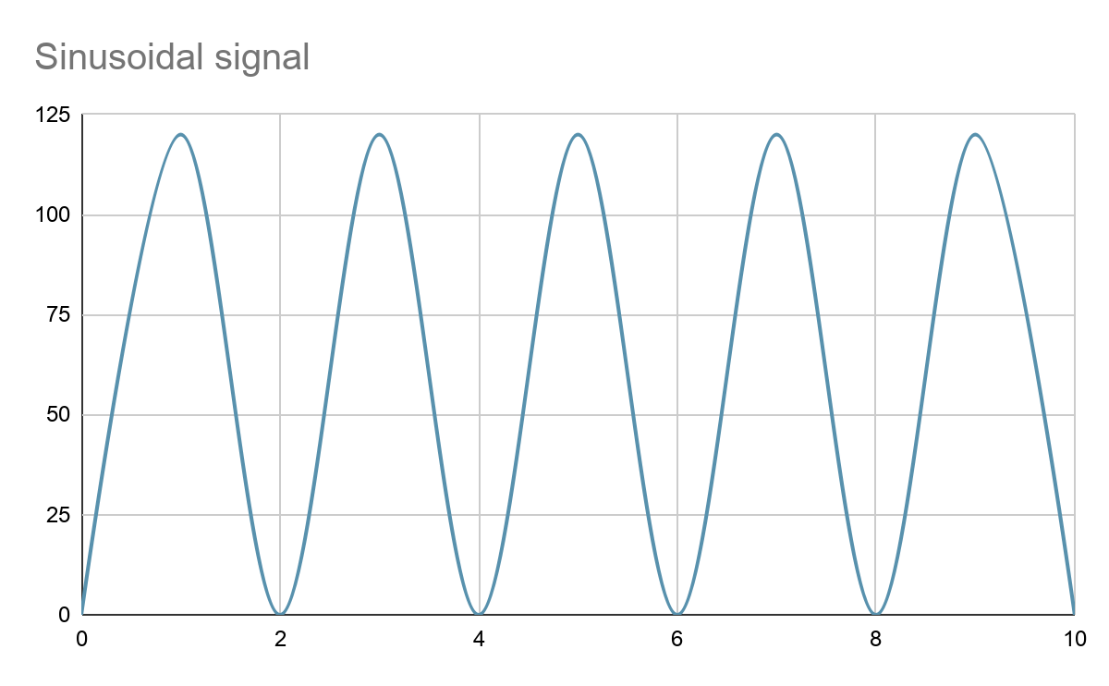
Spatial Frequency
Amplitude
Period = 2
Frequency = 5/10 = 1/2
Frequency
Period

Slide 21
Spatial Frequency
v = 0
2 dimensions = 2 spatial frequencies:
1 following the u axis
1 following the v axis
 | 90
u = 0

Slide 22

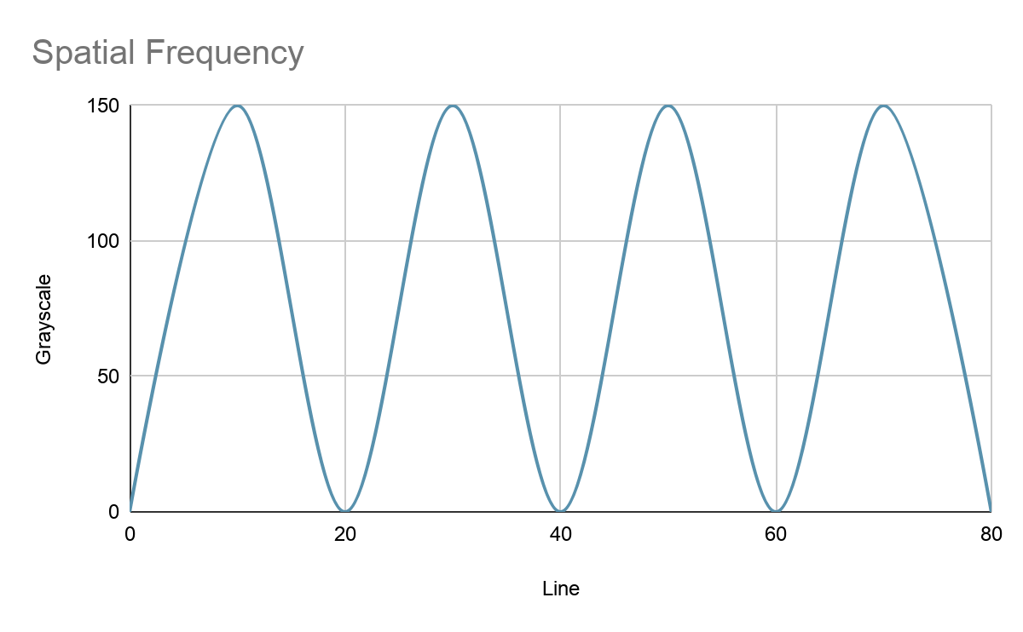
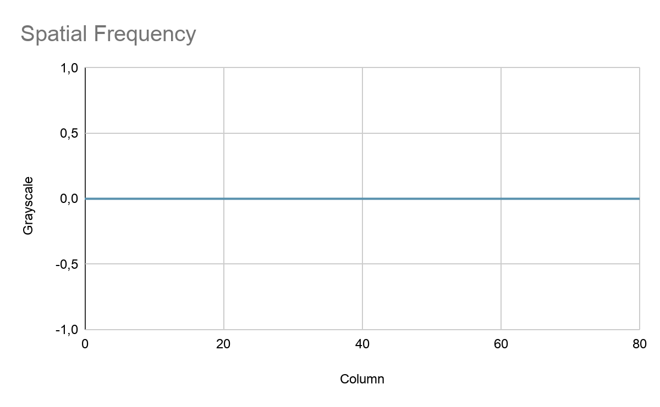
Spatial Frequency
u = 4
V = 0
Period(u) = Line/u = 20
Frequency(u) = u/Line = 0.2
Period(v) = Column/v = 0
Frequency(v) = v/Column = 0

Slide 23

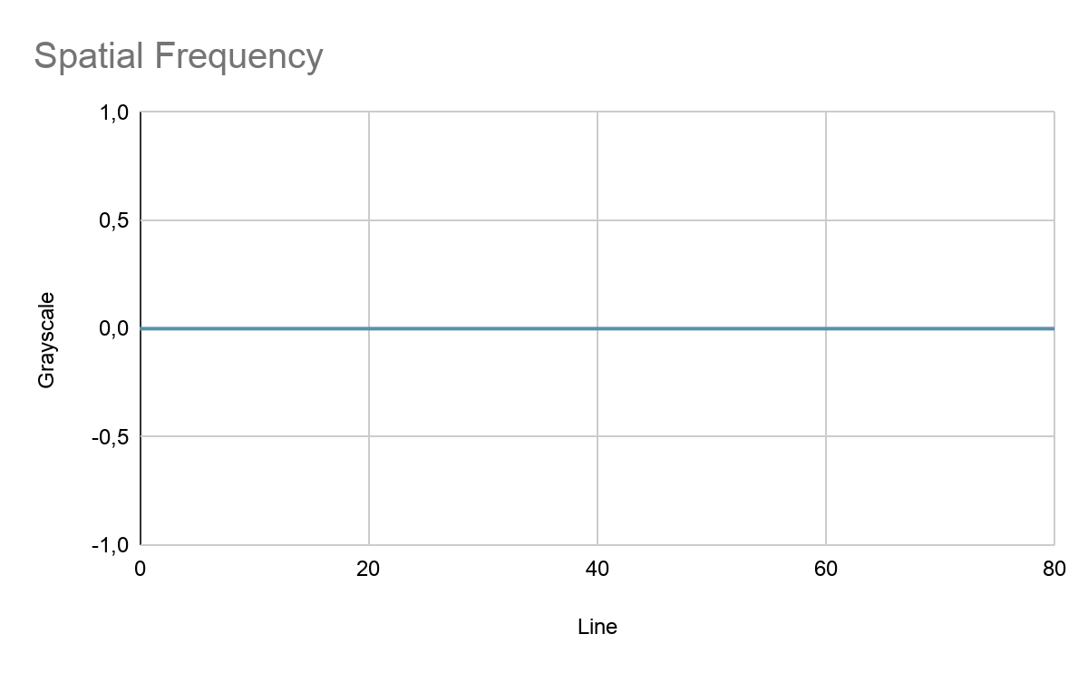
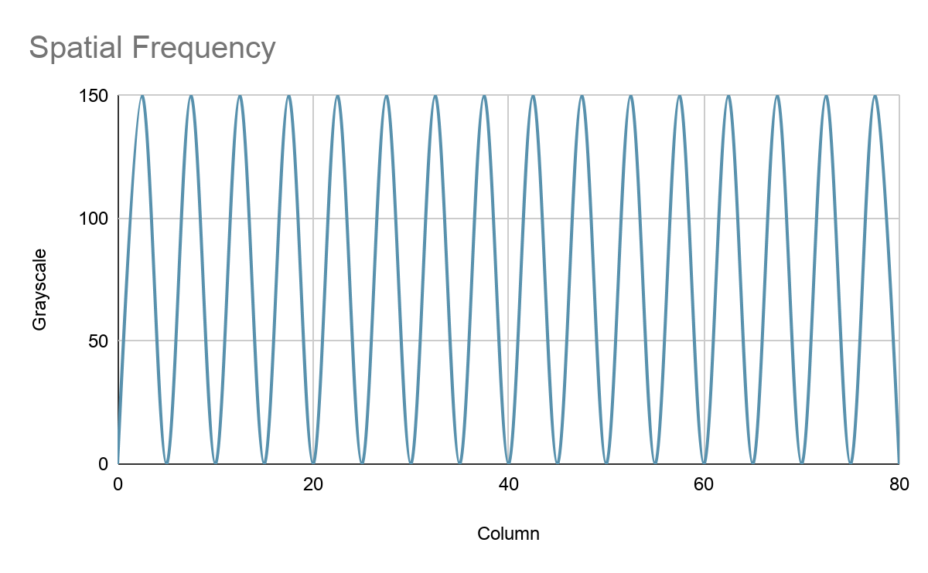
Spatial Frequency
u = 0
V = 16
Period(u) = Line/u = 0
Frequency(u) = u/Line = 0
Period(v) = Column/v = 5
Frequency(v) = v/Column = 0.2

Slide 24

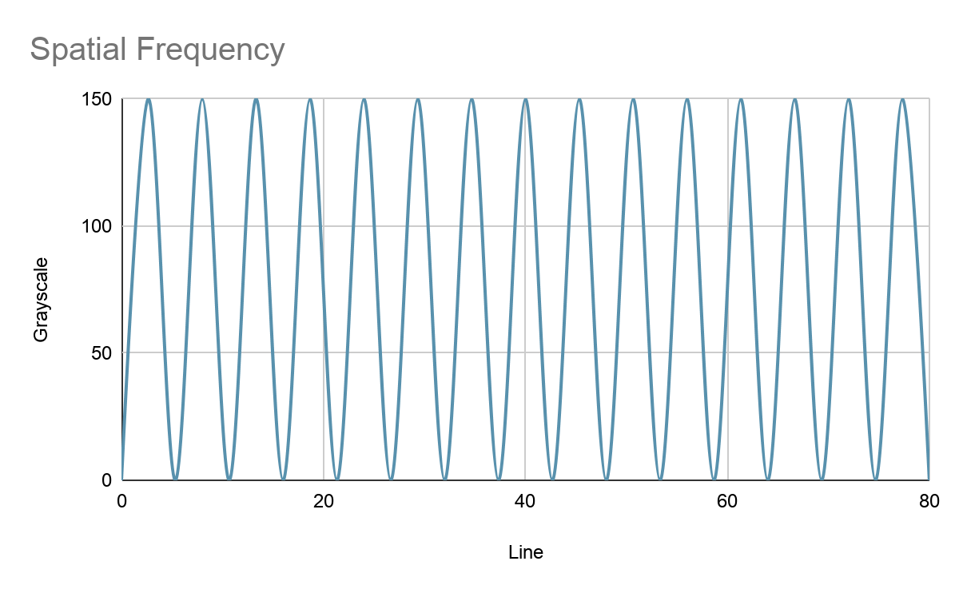
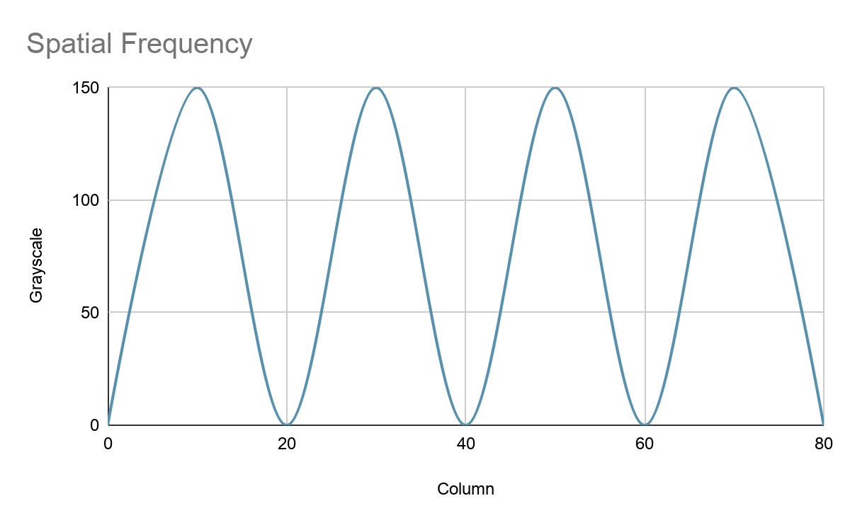
Spatial Frequency
u = 15
V = 4
Period(u) = Line/u = 5.33
Frequency(u) = u/Line = 0.19
Period(v) = Column/v = 20
Frequency(v) = v/Column = 0.2

Slide 25
Spatial Frequency
… (weighted sum of Line X Column images)

Slide 26
Spatial Frequency Filtering
Low-pass filter : keeps only low frequencies. The tinier the filter, the blurrier the image.
High-pass filter: Keeps high frequencies. Useful to extract edges and remove content.
Enhancing filter: keeps low frequencies and amplify high ones.
Notes:
Les filtres passe-haut coupent toutes les fréquences d'amplitude inférieure au rayon. Plus le rayon du filtre est grand, plus il y a de fréquences supprimées. Lorsque le rayon augmente, on supprime de plus en plus d'informations de l'image.
Les filtres passe-bas coupent toutes les fréquences d'amplitude supérieure au rayon. Ainsi un filtre passe-bas a pour effet de supprimer les détails et de lisser (flouter) l'image. Plus le rayon du filtre est grand, moins il y a de fréquences supprimées et moins le filtrage est important. Lorsque le rayon augmente, on supprime de moins en moins d'informations de l'image, et l'image est de plus en plus nette.

Slide 27
Mathematical Morphology Operations
Erosion, dilation, opening & closing

Slide 28
Mathematical Morphologie: Principle
Using a convolution kernel of various shape.
Change the shape of an item inside an image.
Remove some noise without main image content alteration.

Slide 29
Mathematical Morphologie: Erosion
0 | 0 | 0 | 0 | 0 | 0 | 0 | 0
0 | 0 | 0 | 0 | 0 | 0 | 0 | 0
0 | 0 | 1 | 1 | 1 | 1 | 0 | 0
0 | 0 | 1 | 1 | 1 | 1 | 0 | 0
0 | 0 | 1 | 1 | 1 | 1 | 0 | 0
0 | 0 | 1 | 1 | 1 | 1 | 0 | 0
0 | 0 | 0 | 0 | 0 | 0 | 0 | 0
0 | 0 | 0 | 0 | 0 | 0 | 0 | 0
Convolution Kernel
Central pixel remains the same if the whole kernel is included. Else, the pixel changes to the min of the kernel area.
0 | 1 | 0
1 | 1 | 1
0 | 1 | 0

Slide 30
Mathematical Morphologie: Erosion
0 | 0 | 0 | 0 | 0 | 0 | 0 | 0
0 | 0 | 0 | 0 | 0 | 0 | 0 | 0
0 | 0 | 0 | 0 | 0 | 0 | 0 | 0
0 | 0 | 0 | 1 | 1 | 0 | 0 | 0
0 | 0 | 0 | 1 | 1 | 0 | 0 | 0
0 | 0 | 0 | 0 | 0 | 0 | 0 | 0
0 | 0 | 0 | 0 | 0 | 0 | 0 | 0
0 | 0 | 0 | 0 | 0 | 0 | 0 | 0
Convolution Kernel
Central pixel remains the same if the whole kernel is included. Else, the pixel changes to the min of the kernel area.
0 | 1 | 0
1 | 1 | 1
0 | 1 | 0

Slide 31
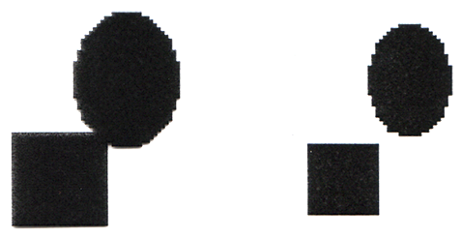

Mathematical Morphologie: Erosion
Useful ? Why ?
Exemple 2
Exemple 1

Slide 32
Mathematical Morphologie: Dilation
0 | 0 | 0 | 0 | 0 | 0 | 0 | 0
0 | 0 | 0 | 0 | 0 | 0 | 0 | 0
0 | 0 | 1 | 1 | 1 | 1 | 0 | 0
0 | 0 | 1 | 1 | 1 | 1 | 0 | 0
0 | 0 | 1 | 1 | 1 | 1 | 0 | 0
0 | 0 | 1 | 1 | 1 | 1 | 0 | 0
0 | 0 | 0 | 0 | 0 | 0 | 0 | 0
0 | 0 | 0 | 0 | 0 | 0 | 0 | 0
Convolution Kernel
1 | 1 | 1
1 | 1 | 1
1 | 1 | 1
For each pixel that has a value of 1, apply the kernel.
Notes:
For each pixel in A that has a value of 1, superimpose B, with the center of B aligned with the corresponding pixel in A.
Each pixel of every superimposed B is included in the dilation of A by B.

Slide 33
Mathematical Morphologie: Dilation
0 | 0 | 0 | 0 | 0 | 0 | 0 | 0
0 | 1 | 1 | 1 | 1 | 1 | 1 | 0
0 | 1 | 1 | 1 | 1 | 1 | 1 | 0
0 | 1 | 1 | 1 | 1 | 1 | 1 | 0
0 | 1 | 1 | 1 | 1 | 1 | 1 | 0
0 | 1 | 1 | 1 | 1 | 1 | 1 | 0
0 | 1 | 1 | 1 | 1 | 1 | 1 | 0
0 | 0 | 0 | 0 | 0 | 0 | 0 | 0
Convolution Kernel
1 | 1 | 1
1 | 1 | 1
1 | 1 | 1
For each pixel that has a value of 1, apply the kernel.
Notes:
For each pixel in A that has a value of 1, superimpose B, with the center of B aligned with the corresponding pixel in A.
Each pixel of every superimposed B is included in the dilation of A by B.

Slide 34


Mathematical Morphologie: Dilation
Useful ? Why ?
Exemple 2
Exemple 1

Slide 35
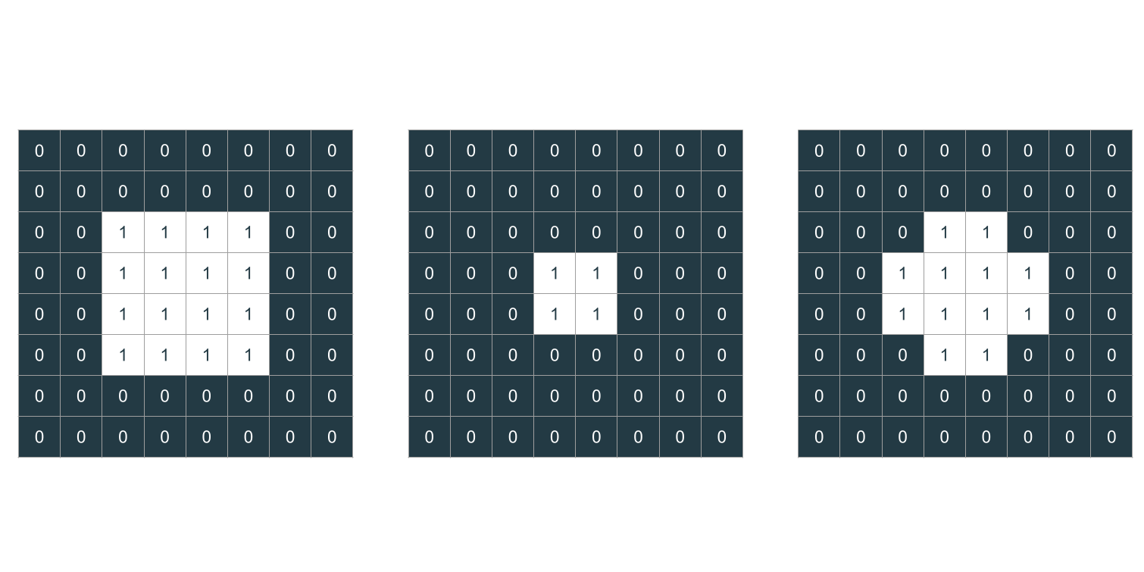
Mathematical Morphologie: Opening
Opening
Erosion
Dilation
Convolution Kernel
0 | 1 | 0
1 | 1 | 1
0 | 1 | 0
Useful to remove small size elements while keeping the global item shape.

Slide 36
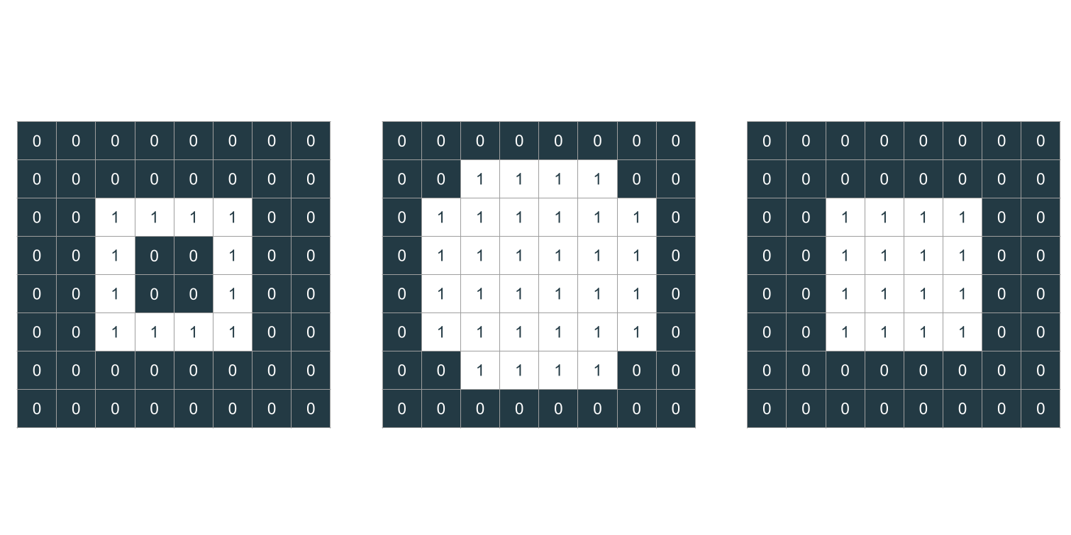
Mathematical Morphologie: Closing
Closing
Dilation
Erosion
Convolution Kernel
0 | 1 | 0
1 | 1 | 1
0 | 1 | 0
Useful to remove small size holes while keeping the global item shape.

Slide 37
Exercices
Coding games & images filtering

Slide 38

Quizz Kahoot !
Link: https://kahoot.it/
Pin: xxxx

Slide 39

Let’s play some Codingame !
easy:
flip the sign
Reverse minesweeper
sudoku validator
lumen
pirate’s treasure
medium:
forest fire
battleship

Slide 40

Filtering: take your favorite image and...
Detect objects inside of them
Exemple: Coke can detector

